Slide 1
Email
<p>Good evening, </p>
<p>As a preview of class on Wedensday, we will be reviewing <a href="https://en.wikipedia.org/wiki/Mathematics">math</a>. Covering hundreds of years of progress in a complex domain will necessarily be superficial, so the goal is to expose you to terms and concepts relevant to your role as a data scientist. </p>
<p>We will spend time exploring <a href="https://en.wikipedia.org/wiki/Probability">probability</a> in a hands-on exercise and do some in-class coding. We will also discuss <a href="https://en.wikipedia.org/wiki/NumPy">numpy</a>, a library for <a href="https://en.wikipedia.org/wiki/Linear_algebra">linear algebra</a>. Experience in <a href="https://www.youtube.com/watch?v=zzbw0JbiI6Y">statistics</a> and calculus and differential equations is not necessary, but being able to know when to apply which concept is helpful as a data scientist. </p>
<p>John </p>

Slide 2
References for Fall 2020
https://news.ycombinator.com/item?id=21628449
http://danaernst.com/resources/free-and-open-source-textbooks/
https://news.ycombinator.com/item?id=21851020

Slide 3
Announcement email: prep prior to class
See Blackboard > Course Materials > Week 7 > notebooks
Students with first character of last name between A and M (inclusive) review "modeling_random_coin_flips_visualization"
Students with first character of last name between N and Z (inclusive) review "python-groupby-tutorial"

Slide 4
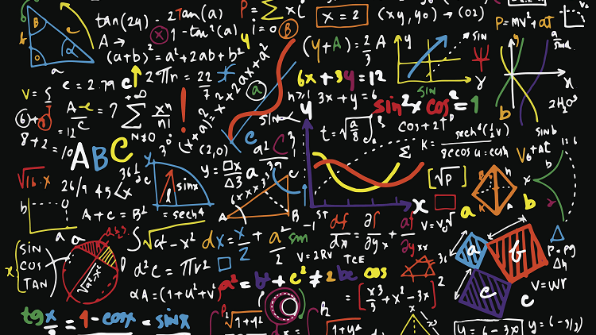
Class 7: Math
How much math do I need to learn to be a data scientist?
Data 601 @ UMBC
These notes are CC BY 4.0
Notes:
http://www.mrbartonmaths.com/blog/tes-maths-newsletter-june-2017/
See also https://web.stanford.edu/class/stats101/intro/intro-lecture01.pdf for inspiration
Useful: https://arxiv.org/pdf/1503.05570.pdf
A Data Science Course for Undergraduates: Thinking With Data by Ben Baumer, The American Statistician Vol. 69 , Issue. 4

Slide 5
Why did we do this openpyxl assignment?
We could just use
pandas.merge(df1,df2,left_on='patient id',right_on='p_id',how='outer')
However, goal is to preserve formulas, cell formatting, charts
Why?
Situation: collaborating with an Excel user
Why not stay in Excel?
Because Excel doesn't scale and is limited and is brittle Why not stay in Pandas?
Because collaboration involves exchange
See demo in week_05_automation/excel_manipulation folder

Slide 6
Project 2 description
You can ask me first if you may use data source you have used in projects 1.
If you are not comfortable having your notebook for project 2 uploaded to a publicly accessible website, please let me know via email.
The intent of project 1 was data exploration, data characterization, data visualization, identifying data issues, and potentially resolving problems in the data.
In project 2, we apply the same techniques as in project 1, but this time we are exploring questions specific to the data. Your proposal will need to include two or more hypotheses about the data you are investigating.

Slide 7
Rest of the Semester timeline
Class | Week | Title
10/14/20 | 7 | Math
10/21/20 | 8 | Time series analysis
10/28/20 | 9 | Clustering
11/04/20 | 10 | Table and graphs
11/11/20 | 11 | Veterans Day
11/18/20 | 12 | Project 2: virtual reproducibility with blackboard
11/25/20 | 13 | "Property Graphs and Tidy Data"
12/02/20 | 14 | Concurrency, Elasticity
12/09/20 | 16 | Study day (no lecture)
12/16/20 | 15 | "Cost/benefit; Ethics"
12/xx/20 | 17 | Final Project Due

Slide 8
Project 2 timeline
October 20 (Tuesday): project 2 proposals are due via Blackboard. Submit your proposal in plain text. Do not include your name in the proposal. The proposal should explain the intent of the analysis. The proposal is graded as a homework. The rubric for the proposal is posted in Blackboard.
November 15 (Sunday): project 2 notebooks are due via Blackboard. Submit your Jupyter notebook. Explain in the notebook where to get the data. Either you or I will upload your project 2 notebook to http://github.com. You will be assigned another person to peer review your project.
November 18 (Wednesday): in class you will attempt to reproduce the results from another submitted projects

Slide 9

Course schedule and outline (scope)
1: Overview of Data Science
2: Python in Jupyter
3: Getting data
4: Data cleanup
5: Automation; Reports
6: Project 1 presentations
7: Math
8: Time series
Scaling up and estimation
Elasticity, Cost/benefit
Property graphs
Ethics and Legality

Slide 10


Activity: discussion
A random partner will be assigned by the instructor
Discuss
A random partner will be assigned by the instructor
Discuss
What to discuss with your partner:
What is your experience with using math?
What is your confidence level?
Experience with practical applications?
Is everything in math known, or is there active research?

Slide 11
Outcomes for this evening
By the end of today's class, you should be able to answer the following:
Randomly select elements from a list
Explain the role of sampling data
Transpose a matrix and a dataframe
Explain uses of Gaussian and uniform distributions
Identify misleading representations of data
Describe three biases that can occur when gathering data

Slide 12

Math and Data Science
Math and Data Science
Probability
Correlation
Sets
Linear Algebra and Numpy
Calculus and Differential Equations
Visualization
Homework

Slide 13
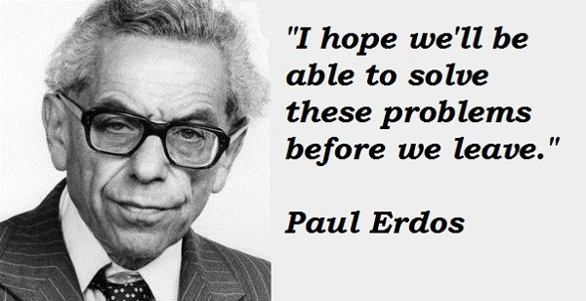
Consider this a survey of an old, diverse field
Linear algebra (vectors, matrices, cross product)
Sets (union)
Combinatorics
Statistics (e.g., mean, median, variance)
How to Lie with Statistics
Error bars
Probability, combinatorics
Calculus
ODEs and PDEs
Caveat: I'm not a mathematician
Notes:
https://www.quora.com/What-are-some-interesting-stories-about-Paul-Erdos

Slide 14
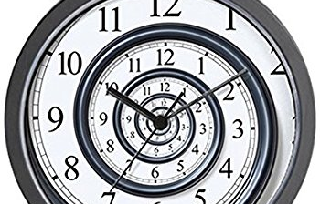
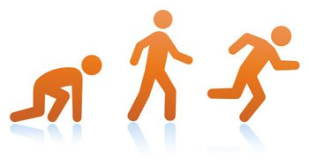
I won't be able to teach you all of Math
Jargon | concept | example

Slide 15
Where Math shows up in Data Science
Explanation of story to audience – what do you expect customers to take away? What is their language?
Analysis of results – visualization, sanity checks
Evaluating test results to validate hypotheses
Enumerating how many permutations are possible
Generating hypotheses that are numerically testable
Modeling expectations – sense-making, distribution of each variable
Cleaning data – filling in gaps for missing data with interpolation

Slide 16
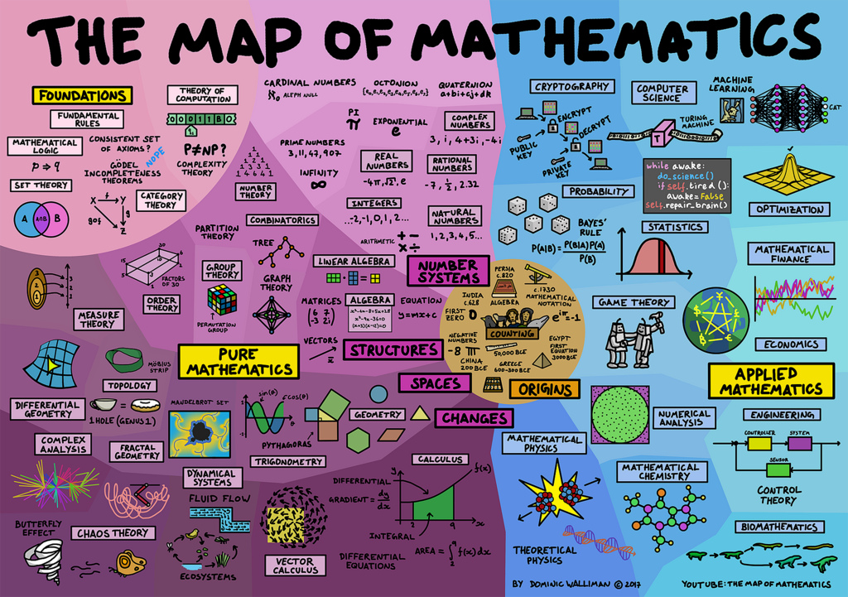

Slide 17
Resources for learning Math
Focus on learning the jargon; this is necessary for searching
For a given topic, evaluate the many options before investing time
Teaching style
Level of complexity
Assumptions about you, the student reader
Free resources
Online (blogs, Coursera, YouTube)
Books

Slide 18
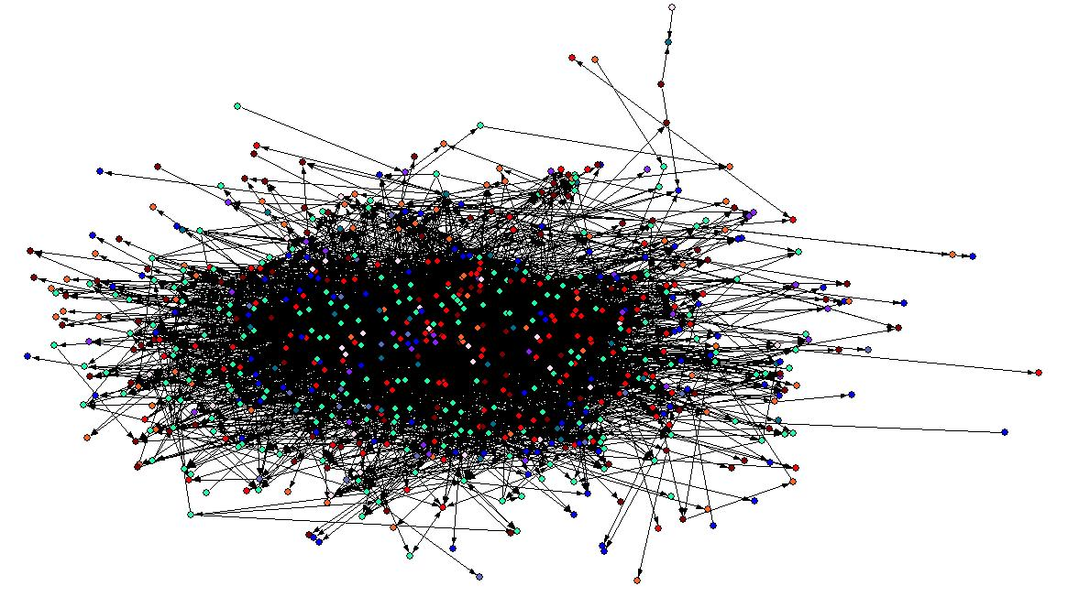
Relevance of Statistics in Data Science
Given randomness and noise, knowledge can be derived from complex data
How:
Quantify relationships between variables in a model using standard language and techniques
Notes:
https://www.amstat.org/asa/files/pdfs/POL-DataScienceStatement.pdf
Graphics from:
http://blog.webometrics.org.uk/2009/04/i-hate-my-job-the-web-is-just-a-jumbled-mess/

Slide 19
Jargon for Quantifying Relations
Numerical
Discrete
Continuous
Categorical
"Ordinal" Ordered Categories
"Nominal" Unordered Categories
Notes:
https://www.ctspedia.org/do/view/CTSpedia/EducationalMaterials055

Slide 20
Discrete versus Continuous variables
Discrete variables: outcomes for coin flips, deck of cards, roll of dice
Continuous variables: time, distance
Continuous: For any two values of a variable, it is possible to get a measurement that is between the two values.

Slide 21

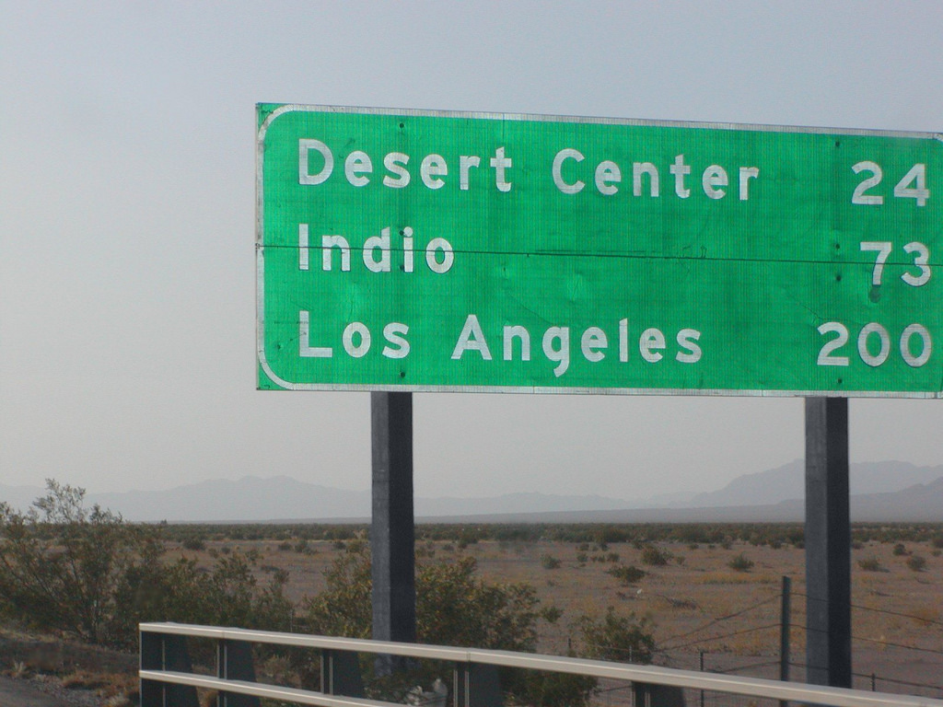
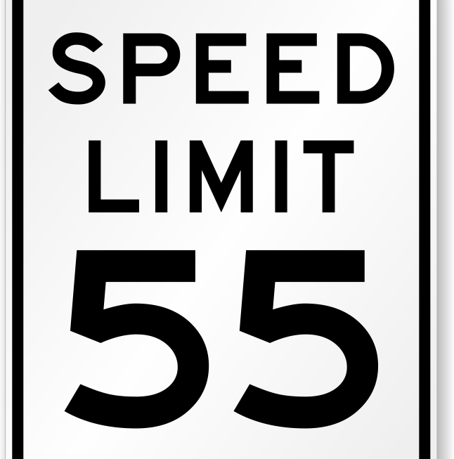

Trick: Rounding continuous to discrete
Rounding is often applied to continuous to make the variable discrete
Notes:
Eye color
Time
Distance
https://www.aao.org/eye-health/tips-prevention/your-blue-eyes-arent-really-blue
https://www.macupdate.com/app/mac/28575/digital-clock
https://www.roadtrafficsigns.com/55-mph-signs

Slide 22
Probability
Math and Data Science
Probability
Correlation
Sets
Linear Algebra and NumPy
Calculus and Differential Equations
Visualization
Homework

Slide 23
Core to Statistics: Probability
Statistics quantifies relationships
between variables in a model
using standard language and techniques
Probability is a way of figuring out an applicable model

Slide 24

Experiments have outcomes

Slide 25
Experiments have outcomes
Outcomes are characterized by a "distribution" of results
Assumption: we can repeat an experiment to get another result

Slide 26


Concept: Uniform distribution
Each outcomes is equally likely:
Chance of any of the possible options is the same as any other outcome
Given a standard deck of 52 cards, what is the chance of getting a card that is a diamond?
Example:
Notes:
https://www.memrise.com/course/753193/memorize-a-deck-of-cards-2/
https://www.allworship.com/deck-cards/

Slide 27
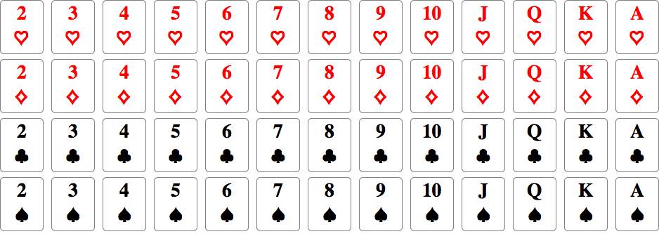
Chance of getting a heart: 13/52
Chance of getting a diamond: 13/52
Chance of getting a club: 13/52
Chance of getting a spade: 13/52
Notes:
https://mathematica.stackexchange.com/questions/16108/standard-deck-of-52-playing-cards-in-curated-data

Slide 28
Randomness and random selection in Python
Randomly select value from list, with each outcome being equally likely:
random.choice( ['red', 'black', 'green'] )
Demo: math/getting_started_with_random.ipynb

Slide 29
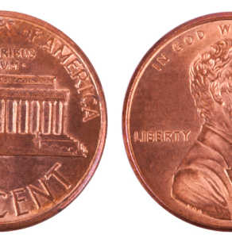
Activity: Coin toss
Using your penny, write down (in order) tails/heads for 10 flips
Example :
1: heads
2: heads
3: tails
4: tails
5: heads
6: tails
7: tails
8: heads
9: heads
10: heads
Notes:
https://connexcu.wordpress.com/2013/07/16/dont-flip-a-coin-on-your-financial-future/

Slide 30
How many possible permutations?
1 flip has 2 outcomes: head (H) or tails (T)
2 flips --> 4 outcomes: HH or HT or TH or TT
3 flips --> 8 outcomes: HHH,HHT,HTH,THH,HTT,THT,TTH,TTT
4 flips --> 16 outcomes: HHHH,HHHT,HHTH,HTHH,THHH,HHTT,...
...
For N flips there are 2^N outcomes
N=10 flips: 2^10= 1,024 outcomes
N=20 flips: 2^20=1,048,576 outcomes

Slide 31
Activity: Pair programming
Find your (randomly selected) partner
Design (on paper) what needs to happen to simulate a sequence of coin flips
In Jupyter, write a function that counts how many coin flips it takes to find the sequence you flipped.
Note: there are at least two ways to interpret this request
Don't stress if you don't complete the task during class

Slide 32
A solution to modeling coin flips
Demo: modeling_random_coin_flips.ipynb

Slide 33
What is that code doing?
Demo: To watch how code executes, check out
http://pythontutor.com/visualize.html

Slide 34
Activity: You present Visualizing probabilistic outcomes
A fair deck of cards has a uniform distribution of outcomes for a given selection
A fair coin has a uniform distribution of outcomes
If your last name starts with A – M,
you Demo: modeling_random_coin_flips_visualization.ipynb
to a student whos name ends with N-Z

Slide 35
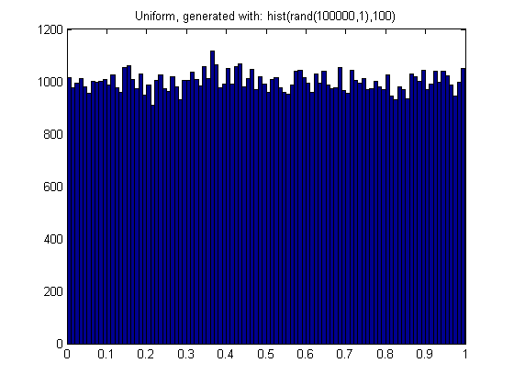
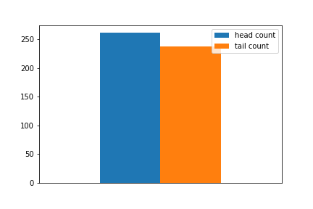
Visualizing probabilistic outcomes for Uniform distribution
Two outcomes:
many outcomes:

Slide 36
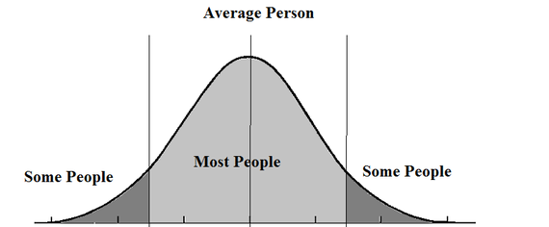
Another distribution: the Bell curve
Notes:
https://stackoverflow.com/questions/13844944/random-numbers-with-gaussian-and-uniform-distributions-in-matlab/13845800
https://www.huffingtonpost.com/hans-hickler/pay-attention-to-the-midd_b_5924640.html

Slide 37
More formally, Gaussian Distribution and Binomial Distribution
binomial distribution is discrete; normal (Gaussian) is continuous
Characteristics of binomial variable:
A fixed number of repeated, identical, independent trials. 𝑛 is usually the parameter chosen to label the number of trials.
Every trial results in either a success, with probability 𝑝, or a failure, with probability 1−𝑝. These must be the only two possible outcomes for a trial.
The random variable of interest is the total number of trials that ended in a success.
Notes:
https://www.quora.com/Probability-statistics-What-is-difference-between-binominal-poisson-and-normal-distribution

Slide 38
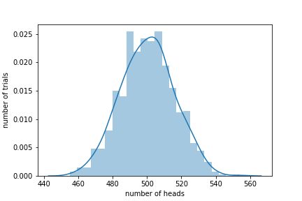
Coin flips produce a bell curve!
An exploration of the coin flips:
Demo: binomial_distribution_for_coin_flips.ipynb

Slide 39
What is the relation between the curves?
Uniform distribution for single trial
Binomial distribution for many trials
Single experiment
Many experiments

Slide 40
Results vary: Error bars tell by how much
Confidence Interval = certainty of what the mean value is
Confidence interval improves when more data is added
Distinct from
Variance measures the width of a distribution
Standard deviation is sqrt(variance) and has same units as variable
Variance and Standard Deviation do not change as the population size increases
Visually include info about distribution of variable in Violin plots
Notes:
https://en.wikipedia.org/wiki/Checking_whether_a_coin_is_fair
https://matplotlib.org/gallery/statistics/boxplot_vs_violin.html
https://blog.modeanalytics.com/violin-plot-examples/

Slide 41
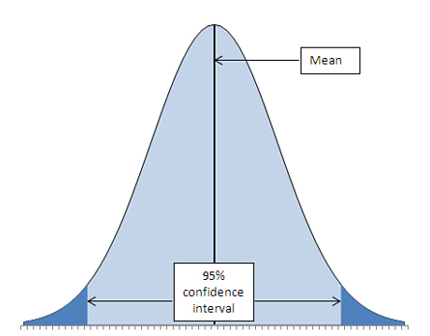
Results vary: Error bars tell by how much
Confidence Interval = certainty of what the mean value is
Confidence interval narrows when more data is added
Distinct from
Variance measures the width of a distribution
Standard deviation is sqrt(variance) and has same units as variable
Variance and Standard Deviation do not change as the population size increases
Notes:
Image source: http://ptgmedia.pearsoncmg.com/images/chap7_9780789747204/elementLinks/07fig06.jpg
http://www.stat.yale.edu/Courses/1997-98/101/confint.htm
https://en.wikipedia.org/wiki/Checking_whether_a_coin_is_fair
https://matplotlib.org/gallery/statistics/boxplot_vs_violin.html
https://blog.modeanalytics.com/violin-plot-examples/

Slide 42
Do we have to rely on experiments?
What if the system being studied is complex?
Expensive to replicate?

Slide 43
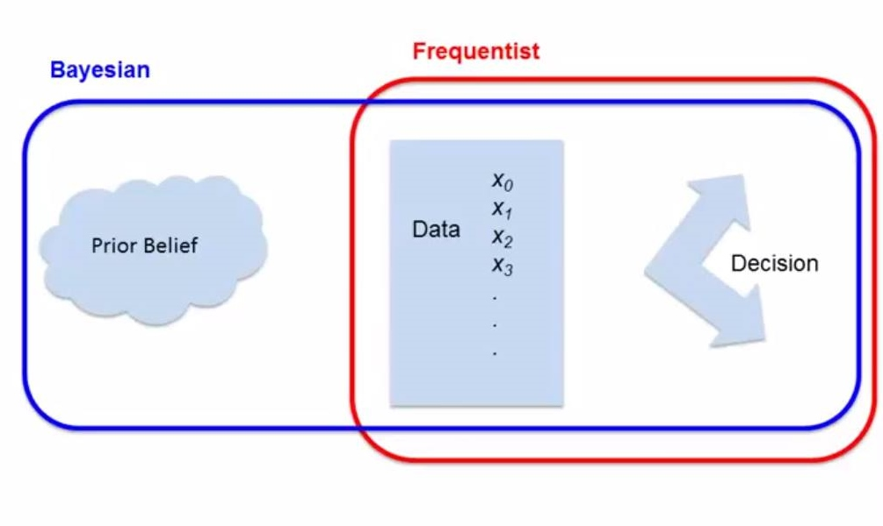
Bayesian versus Frequentist inference
Frequentist approach measures repeated events and does not depend on a subjective prior that may vary from one investigator to another.
Bayesian inference: "What is the probability that it recently rained given that it is wet outside?"
Both approaches allow evaluation of evidence about competing hypotheses.
Jake VanderPlas on difference
Notes:
https://www.datascience.com/blog/introduction-to-bayesian-inference-learn-data-science-tutorials
https://ocw.mit.edu/courses/mathematics/18-05-introduction-to-probability-and-statistics-spring-2014/readings/MIT18_05S14_Reading20.pdf
https://datascienceinsider.wordpress.com/2015/09/17/frequentist-vs-baysian-a-never-ending-debate/

Slide 44
Correlation
Math and Data Science
Probability
Correlation
Sets
Linear Algebra and Numpy
Calculus and Differential Equations
Visualization
Homework

Slide 45
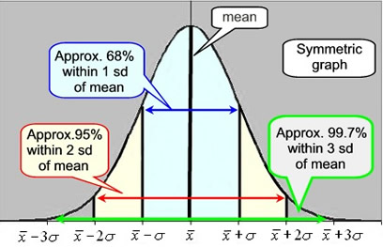
Two events are statistically independent of each other when the probability that one event occurs in no way affects the probability of the other event occurring.
Variance measures width of a distribution
Covariance is the measure of variance for two random variables (joint variability)
Correlation is the normalized covariance, from –1 to 1
More explanation here and visualizations of covariance are helpful
Notes:
Picture source: https://mathbitsnotebook.com/Algebra1/StatisticsData/STSD.html

Slide 46
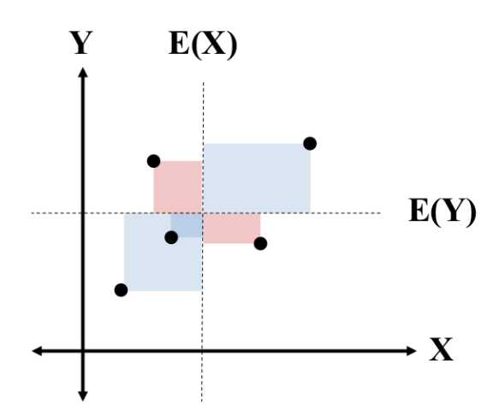
Visualize covariance
Pink areas are less than the average,
so the area has a negative value when summing areas

Slide 47

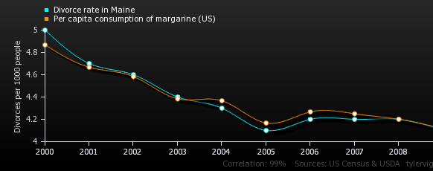
Correlation = 0.992558 for Divorce and Margarine
http://www.tylervigen.com/spurious-correlations
Notes:
https://tylervigen.com/view_correlation?id=1703

Slide 48
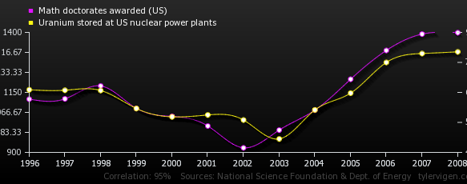
Correlation = 0.952257 for PhDs and Uranium
https://tylervigen.com/view_correlation?id=1100

Slide 49
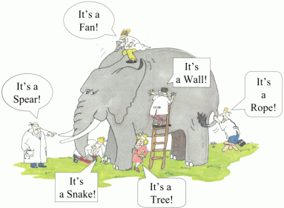
How to (un)intentionally mislead
Counting and math are objective
Collection, analysis, and interpretation of data is implemented by humans
Consequence: data you work with
may have issues you need to account for
Notes:
https://cseweb.ucsd.edu/~ricko/CSE3/Lie_with_Statistics.pdf
https://www.spencerburton.ca/learning-is-subjective/

Slide 50
Data collection: exhaust or sample?
Sampling a population can introduce bias
Area Bias – geographic area of sample needs to be representative of study population
Self-Selection Bias - decision to participate may correlate with traits that affect the study
Leading Question Bias - tone of the question suggests the answer
Social Desirability Bias - reluctance to admit to doing something that is considered socially undesirable
Notes:
Source: https://cseweb.ucsd.edu/~ricko/CSE3/Lie_with_Statistics.pdf

Slide 51
Correlation
Math and Data Science
Probability
Correlation
Time series
Sets
Linear Algebra and Numpy
Calculus and Differential Equations
Visualization
Homework

Slide 52
Reminder of “How to Science”
Observation = Data
Curiosity about relations
Model = a story using math to describe relations in the data
Prediction = based on assumptions
Test = (in)validate assumptions
Notes:
https://www.youtube.com/watch?v=j12BBcKSgEQ

Slide 53
Relevance of folklore in Data Science
I talk to people
to discover their folklore
Observation = Data
Curiosity about relations
Model = a story using math to describe relations in the data
Prediction = based on assumptions
Test = (in)validate assumptions
You have an internal model of the world you can leverage when starting to explore data
Notes:
https://www.youtube.com/watch?v=j12BBcKSgEQ

Slide 54
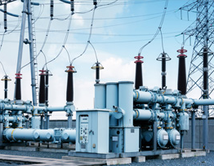
Activity: sketch your expectation on paper
Axes:
Time (days)
Power (megawatts)
Notes:
http://www.threephaseline.com/

Slide 55
Activity: sketch your expectation on paper
Randomly select presenter
Display your sketch on the projector
Get feedback from your peers
Notes:
http://www.threephaseline.com/

Slide 56
Time varying data
Source: https://www.bmreports.com/bmrs/?q=demand/rollingsystemdemand
Demo:
visualizing_time_variation_v1
visualizing_time_variation_v3
visualizing_time_variation_v4
visualizing_time_variation_v5_final_product_looks_easy.ipynb
Notes:
Hook: what's the motivator ?

Slide 57
Time varying data
Source: https://www.bmreports.com/bmrs/?q=demand/rollingsystemdemand
Demo:
visualizing_time_variation_v5_final_product_looks_easy.ipynb
The point of this notebook is that we can tell stories about data just by starting with a scatter plot
In the future, we will discuss a mathematical approach, rather than just relying on visual analysis: Fourier transform​
Notes:
Hook: what's the motivator ?

Slide 58
Activity: You present Groupby
source: https://www.kaggle.com/crawford/python-groupby-tutorial
Advanced: http://wesmckinney.com/blog/groupby-fu-improvements-in-grouping-and-aggregating-data-in-pandas/
If your last name starts with N to Z, you present
Demo python-groupby-tutorial.ipynb
to another student whose last name starts with A to M.

Slide 59
Cyclic patterns in time varying data
Chrome history analysis
Demo: histogram_of_my_Chrome_history.ipynb

Slide 60
Cyclic patterns in time varying data
Chrome history analysis
Demo: histogram_of_my_Chrome_history.ipynb
The point of this notebook is that we can tell stories about data using bar diagrams

Slide 61
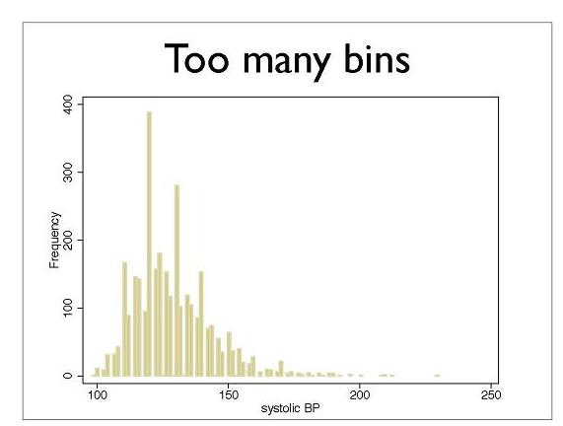
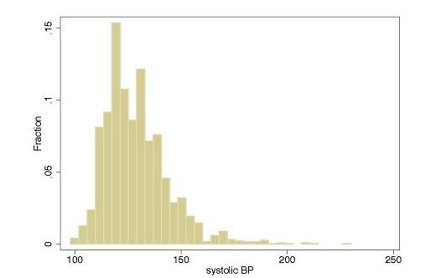
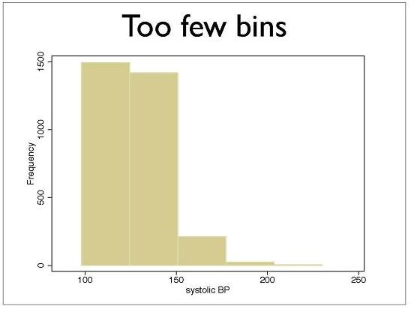
Subjective Design decisions of Histograms
What visualizations are possible?
https://datavizcatalogue.com/
Helpful walk through of design:
https://tinlizzie.org/histograms/
Notes:
https://www.ctspedia.org/do/view/CTSpedia/EducationalMaterials055
See also https://dataviz-literacy.wmflabs.org/#section-common-visualizations

Slide 62
Sets
Math and Data Science
Probability
Correlation
Sets
Linear Algebra and Numpy
Calculus and Differential Equations
Visualization
Homework

Slide 63
Browser history for two people
How would you find which websites both have visited?

Slide 64



Sets are collections of items
Stuff I own now

Slide 65


Sets are collections of items
I owned 10 years ago

Slide 66
Sets are collections of items
Stuff I own now
I owned 10 years ago

Slide 67
Set intersection (and); Set union (or)
Intersection = the overlap of one or more sets
Union = combination of one or more sets
Demo:
sets.ipynb

Slide 68
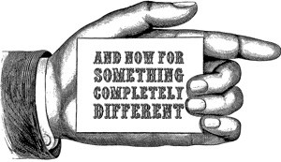

Slide 69
Linear Algebra and Numpy
Math and Data Science
Probability
Correlation
Sets
Linear Algebra and Numpy
Calculus and Differential Equations
Visualization
Homework

Slide 70
Relevance of Linear Algebra to Data Science
Central to machine learning
Images are arrays of numbers
Text processing (i.e. word2vec)
Neural network weights are stored as array
Principal Component Analysis (PCA) - lossy dimensionality reduction
https://www.khanacademy.org/math/linear-algebra

Slide 71
NumPy and dimensions of data
NumPy is short for Numerical Python
Scalar values, i.e. 5
1 dimension
Numpy: array – single type of entries
Python: list, set (unique elements), tuple (immutable)
Linear algebra: vector
2 dimensions:
CSV: Table; Excel: worksheet
Numpy: array of arrays
Linear algebra: matrix
Demo: introduction_to_numpy_and_vectors_and_matrices.ipynb

Slide 72
Calculus and Differential Equations in Data Science
Math and Data Science
Probability
Correlation
Sets
Linear Algebra and Numpy
Calculus and Differential Equations
Visualization
Homework

Slide 73
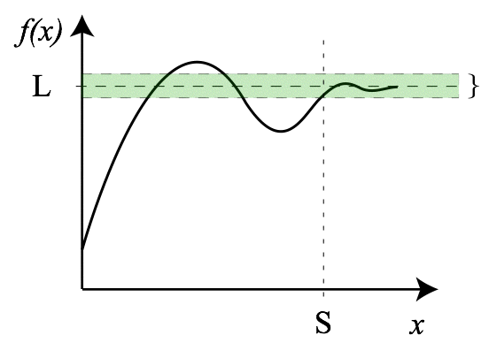
Calculus as gateway to Differential Equations
Calculus: approximation that summing a large number of small things yields a finite value.
Curious about what calculus covers?
See this review of concepts and essential concepts.
https://www.khanacademy.org/math/multivariable-calculus
Notes:
https://en.wikipedia.org/wiki/Limit_(mathematics)

Slide 74

Relevance of Differential Equations in Data Science:
Differential equations enable determination of rate of change of quantities
(When the rate of change is zero, you are bored)

Slide 75
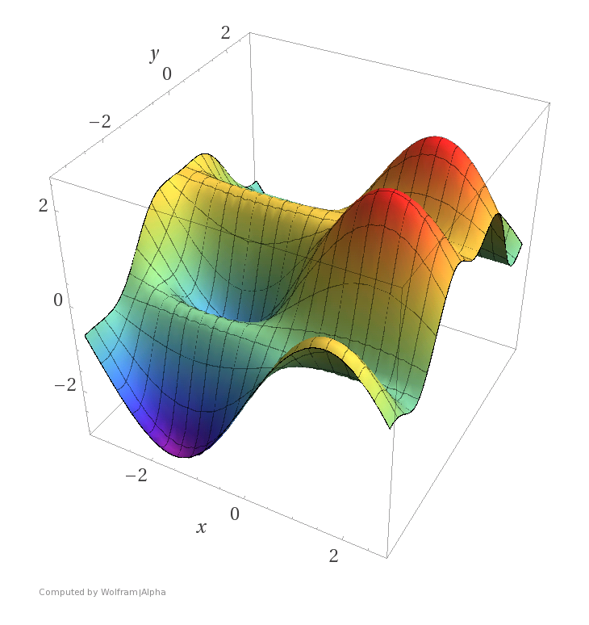
Relevance of Differential Equations in Data Science
Differential equations enable determination of rate of change of quantities
Optimization, which is central to machine learning (i.e. Gradient descent)
As with most topics in this lecture, there are entire courses and textbooks dedicated to optimization.
There are other applications
Free courses on differential equations are available online
Notes:
https://www.matroid.com/blog/post/the-hard-thing-about-deep-learning

Slide 76
What does a data scientist do all day?
I have autonomy because my employer expects I know what I'm doing
Work from 9 to 5 M-F, or 10 to 4, or whatever suits my needs
Read and write emails.
Go to meetings; run meetings
Have impromptu discussions with stakeholders
Write documentation, read papers
Write code
Manage data
No day repeats
No day is predictable
https://www.kdnuggets.com/2017/11/day-life-data-scientist.html
Notes:
https://www.kdnuggets.com/2017/11/day-life-data-scientist.html

Slide 77
Visualization
Math and Data Science
Probability
Correlation
Sets
Linear Algebra and Numpy
Calculus and Differential Equations
Visualization
Homework

Slide 78
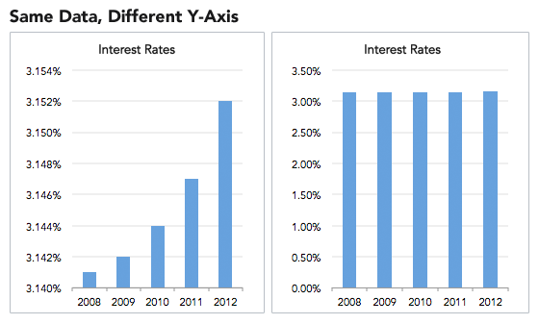
Knowing Math insufficient in story telling: Misleading Visualizations
Notes:
https://heapanalytics.com/blog/data-stories/how-to-lie-with-data-visualization

Slide 79
No one would actually do that, right?

Slide 80
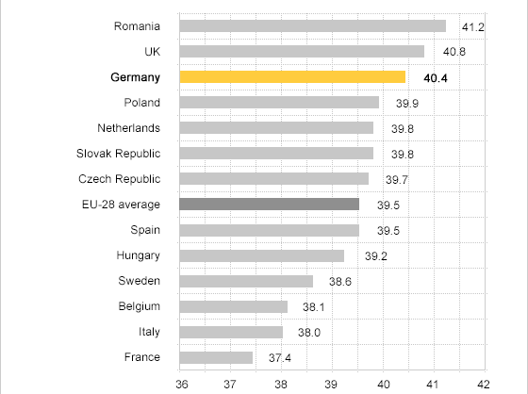
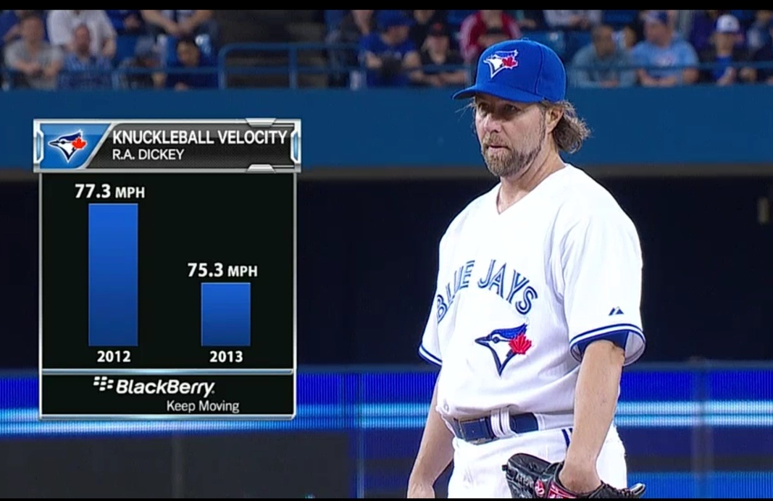
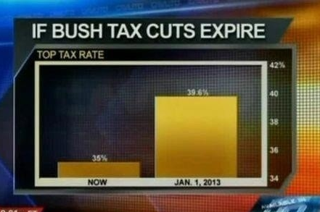
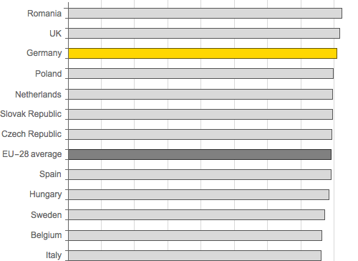
Oh yes
Complete data:
(There are conditions under which not including zero is justified.)
Notes:
https://heapanalytics.com/blog/data-stories/how-to-lie-with-data-visualization
https://callingbullshit.org/tools/tools_misleading_axes.html
https://callingbullshit.org/case_studies/case_study_musician_mortality.html
https://callingbullshit.org/tools/tools_proportional_ink.html

Slide 81
Mistakes when Characterizing data
Even "find the average" isn't as trivial as you may think
Arithmetic mean : what you're used to
Harmonic mean : appropriate when the average of rates is desired
Geometric mean : combining multiple parameters which have different ranges so that a given percentage change in any of the properties has the same effect

Slide 82
XKCD
https://www.explainxkcd.com/wiki/index.php/882:_Significant
https://xkcd.com/1122/
https://xkcd.com/882/
https://xkcd.com/1478/

Slide 83
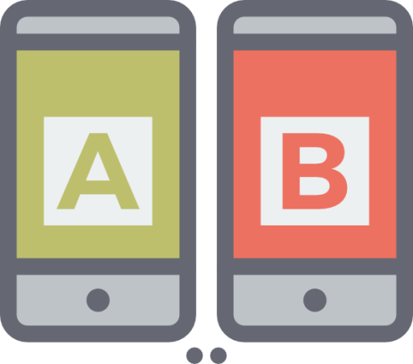
There's more than Exploratory Data Analysis
Comparing models using A/B testing
Notes:
https://www.mugo.ca/Blog/Why-A-B-testing-is-an-important-part-of-your-digital-strategy

Slide 84
Where does A/B testing get used?
Website design
Email marketing
Useful when the audience being evaluated is sufficiently large to be statistically meaningful
Typically evaluating response with respect to an outcome
https://www.candyjapan.com/behind-the-scenes/ab-testing-landing-page-template​
https://news.ycombinator.com/item?id=19398491

Slide 85
Homework
Math and Data Science
Probability
Correlation
Sets
Linear Algebra and Numpy
Calculus and Differential Equations
Visualization
Homework

Slide 86
Reading Assignment
Read the paper
"Can Graphics Tell Lies? A Tutorial on How To Visualize Your Data" in Clinical and Translational Science (2018) 11, 371–377; doi:10.1111/cts.12554
www.ncbi.nlm.nih.gov/pubmed/29603646

Slide 87
Homework 1
All pictures in all homeworks and reports are to be generated dynamically
Acquire power data from this source for at least 10 days and not more than 40 days. The website limits the window size, so you will need to download multiple files. Load the data into a Jupyter Notebook
Combine the multiple input files to create a single dataframe.
Create two bar graphs of the power consumption per hour.
One bar graph has 24 bars; each bar is the average across all days for that hour
one bar graph has 24*(number of days) bars.
Submit the .ipynb file containing the analysis and the generated pictures.
Help on visualizations
Notes:
https://stackoverflow.com/questions/479236/how-do-i-simulate-biased-die-in-python

Slide 88
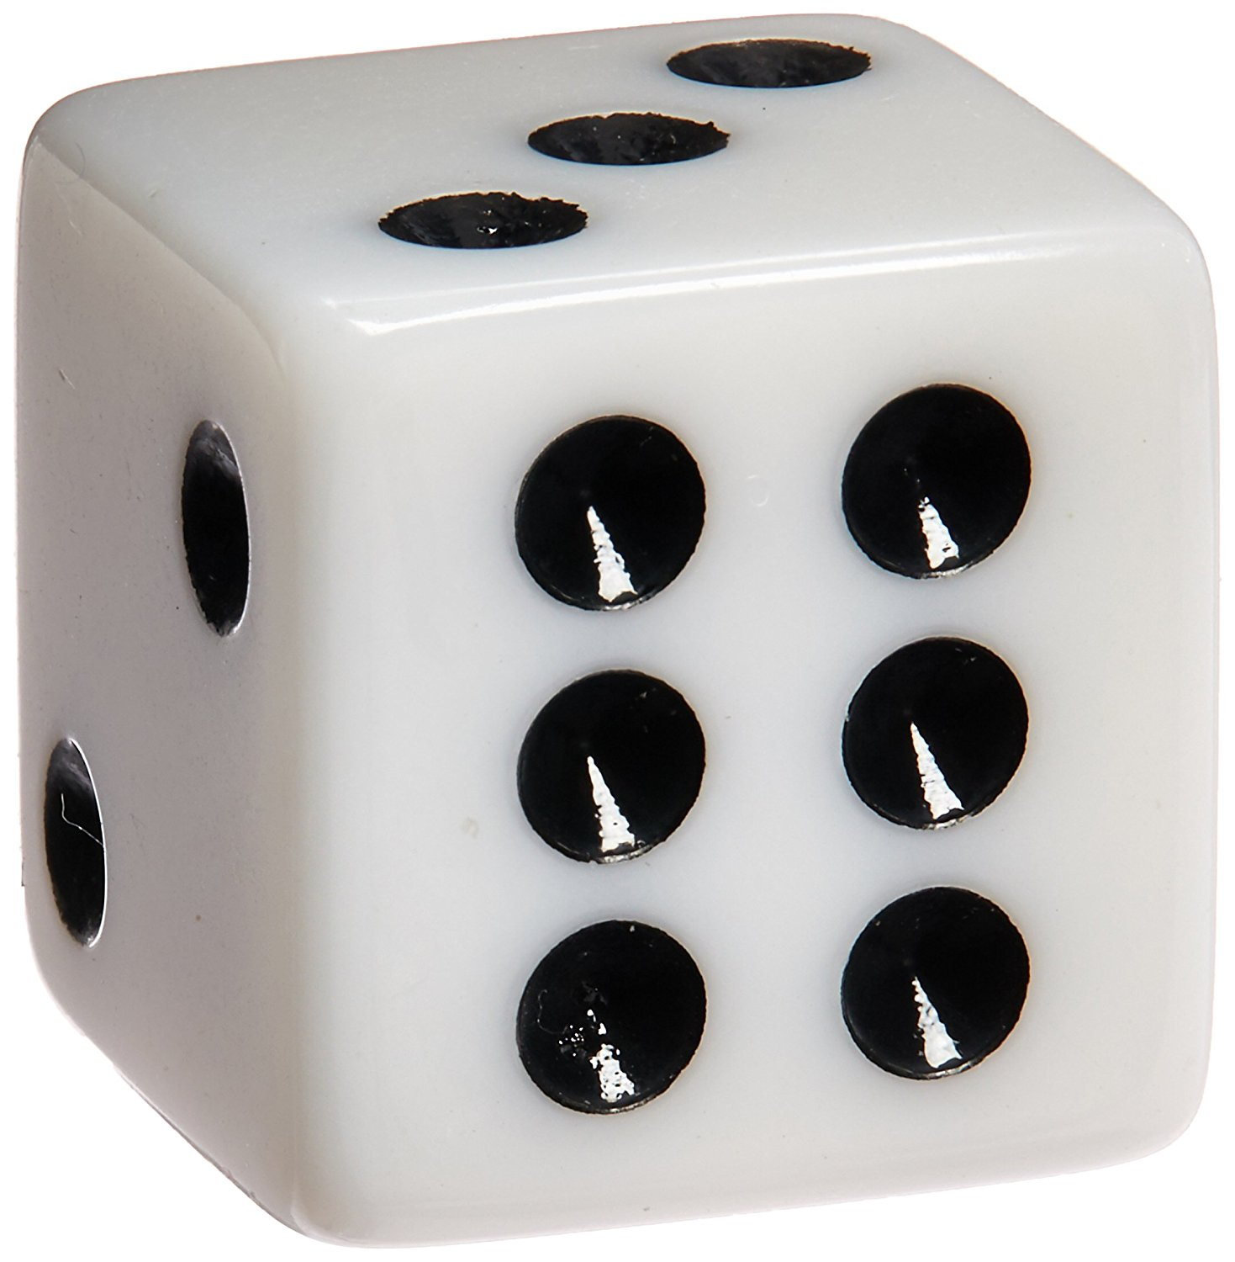
Homework 2
All pictures in all homeworks and reports are to be generated dynamically
Simulate a fair die and a biased 6-sided die. The biased die has probabilities {0.15, 0.15, 0.15, 0.15, 0.15, 0.25}. Create a visualization that compares outcomes of multiple rolls of a fair die and this biased die. You can use a single visualization or multiple visualizations to demonstrate the difference in outcomes for the dice. The user of your notebook should be able to alter the number of simulations as an argument to a function.
Help on visualizations
Notes:
https://stackoverflow.com/questions/479236/how-do-i-simulate-biased-die-in-python

Slide 89
Breakdown each Homework assignment, Part 1 of 2
Draw or write down what you're starting with
Draw or write down what the outcome should look like

Slide 90
Design your approach to solving problem
On a piece of paper, write down actions you'll need to take
Determine the dependencies among the actions you need to take
In what order should the steps be?
If you have time before leaving, take the listed actions using your computer

Slide 91
Check-in activity
Find a partner you haven't talked with previously (or at least recently)
Talk:
Explain to your partner two things you learned (or confirmed) during this class

